Slide 1


Introduction to
Robotic Process Automation
Smart Automated
Letter Generator
Your Register No: 220701121
Name : Kavibalan P
Guide Name: Mrs. J. Jinu Sophia
Designation and Department: Assistant Professor (SG) &CSE

Slide 2
Abstract
The Smart Automated Letter Generator is a comprehensive IRPA (Intelligent Robotic Process Automation) project designed to simplify and enhance the recruitment process by automating the creation and distribution of offer letters. Developed using UiPath's Robotic Enterprise (RE) Framework, the project ensures a structured and reliable automation flow, minimizing human intervention and errors. The process begins by reading data from an Excel sheet, where candidate statuses are maintained. Candidates marked as "hired" are automatically identified, and personalized offer letters are generated dynamically for each of them. These letters are then emailed directly to the candidates using UiPath's email automation activities. This automation significantly reduces the time and effort required for manual letter generation and distribution, allowing HR professionals to focus on more strategic tasks. This project not only enhances operational efficiency but also sets a benchmark for leveraging technology to optimize repetitive and time-consuming tasks.

Slide 3
Need for the Proposed System
Automation of Repetitive Tasks:
Manual generation and mailing of recruitment letters require significant effort and attention to detail. Automating this process using Robotic Process Automation (RPA) eliminates redundancy and frees up human resources for more strategic tasks.
Minimization of Errors: Human errors in candidate details or letter formatting can lead to miscommunication and negatively impact the organization's reputation. The automated system ensures accuracy in candidate information and standardized letter generation.
Improved Candidate Experience: Candidates receive their offer letters promptly and accurately via email, enhancing their onboarding experience and portraying a professional image of the organization.
Streamlined Workflow: The system integrates seamlessly with existing tools such as Excel for data input and SMTP for email dispatch. Using UiPath’s RE Framework ensures robust error handling and efficient workflow management.

Slide 4
Advantages of the Proposed System
Time Efficiency: The system drastically reduces the time required to generate and send offer letters, especially for bulk recruitments. Tasks that previously took hours or days can now be completed in minutes.
Accuracy and Consistency: Automation ensures error-free processing of candidate data, maintaining accuracy in the generated offer letters. This eliminates discrepancies that may arise from manual operations, such as typos or incorrect formatting.
Cost Savings: By automating repetitive and labor-intensive tasks, the system reduces reliance on manual efforts, thereby cutting down operational costs associated with recruitment administration.
Scalability: The system can efficiently handle a growing number of candidates, making it suitable for organizations of all sizes. As recruitment needs increase, the system can scale without additional infrastructure or manpower..
Improved Security:
The use of controlled workflows and secure data handling ensures the confidentiality and integrity of candidate information throughout the process.

Slide 5
Literature Survey
Paper 1: "Robotic Process Automation: A Case Study in the Banking Industry" (M. Romao, J. Costa, C. J. Costa, 2019)
Advantages:
Increased Efficiency: The implementation of Robotic Process Automation (RPA) significantly reduced manual intervention and improved processing speed in banking operations.
Error Reduction: RPA reduced human errors in document processing, leading to more accurate transactions and customer data handling.
Disadvantages:
Initial Implementation Costs: The upfront cost of setting up RPA systems can be high due to the infrastructure and software requirements.
Resistance to Change: Employees may resist the implementation of automation, fearing job loss or significant changes to their work processes.
Dependency on Technology: The reliance on automation can create operational disruptions if there is a failure in the RPA system or its underlying infrastructure.

Slide 6
Literature Survey
Paper 2: "Robotic Process Automation for Document Processing: A Case Study of a Logistics Service Provider" (Gružauskas, V., Ragavan, D., 2020)
Advantages:
Improved Document Management: The RPA system efficiently handles large volumes of documents, ensuring faster processing and reducing backlogs.
Reduced Operational Risk: By automating repetitive tasks, the risk of human error in critical document processes is greatly reduced.
Disadvantages:
Complexity in Setup: Configuring RPA for diverse document types and workflows can be complex and time-consuming.
Limited Flexibility: RPA is typically rule-based, which may limit its ability to handle more complex or dynamic tasks that require human judgment.
Maintenance: The system may require constant monitoring and maintenance to adapt to changes in document formats or regulatory requirements.

Slide 7
Main Objective
The proposed system automates the end-to-end workflow of recruitment offer letter generation and dispatch. It is designed to read data from an Excel sheet, specifically identifying candidates marked as 'hired,' and then generating personalized offer letters for each of them. The generated letters are formatted in a professional template and sent to the candidates' email addresses through an integrated SMTP service.
Key functionalities include:
Data Extraction: Reads candidate details such as name, email address, and other required fields from an Excel file.
Offer Letter Generation: Automatically creates offer letters using pre-defined templates, ensuring accuracy and uniformity.
Email Dispatch: Sends the offer letters via email to the respective candidates, ensuring timely communication.
Error Handling and Logging: Incorporates robust error-handling mechanisms using UiPath’s RE Framework to log any issues during execution and ensure process continuity.

Slide 8
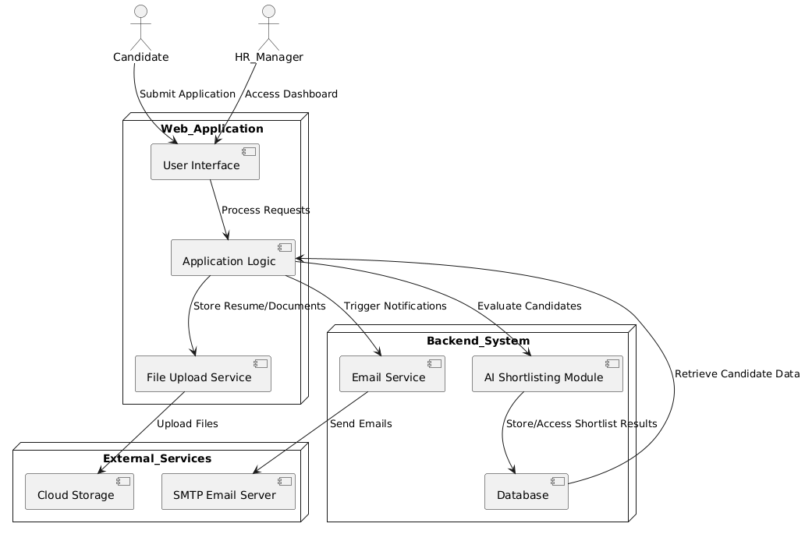
Architecture

Slide 9
System Requirements
Hardware Requirements
Processor: Intel Core i5 or higher
RAM: Minimum 8 GB (16 GB recommended for better performance)
Storage: 50 GB of free disk space
Display: 1366 x 768 resolution or higher
Network: Stable internet connection for SMTP and email functionalities
Software Requirements:
Operating System: Windows 10 or later
Development Tools:UiPath Studio (with RE Framework pre-configured)
Database: Not required (data handled through Excel)
Email Service: SMTP server configuration (e.g., Gmail, Outlook)
Dependencies:
Any required UiPath packages (Excel activities, Mail activities, etc.)
Email client or API (SMTP-enabled configuration)

Slide 10
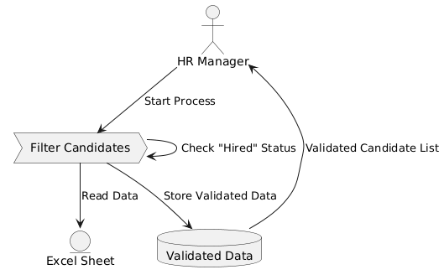
Functional Description
Module 1: Candidate Data Processing
Short Description:
This module is responsible for reading the candidate data from an Excel sheet, identifying candidates with the "Hired" status, and extracting relevant details (e.g., Name, Email, and Role). It ensures accurate data validation and segregation for subsequent processes.
DFD / Activity Diagram:
Level 0 DFD:
Input: Excel Sheet
Process: Filter candidates with "Hired" status
Output: Validated candidate list

Slide 11
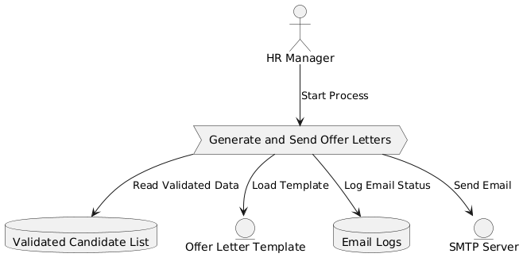
Functional Description
Module 2: Offer Letter Generation and Emailing
Short Description:
This module generates personalized offer letters for each validated candidate using pre-defined templates. The generated offer letters are sent to the candidates' email addresses via an SMTP server.
DFD / Activity Diagram:
Level 0 DFD:
Input: Validated candidate list, Offer letter template
Process: Generate offer letters and send emails
Output: Offer letters sent to candidates

Slide 12
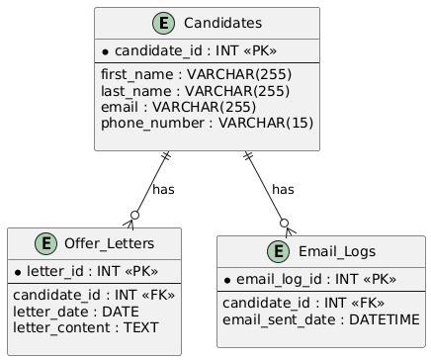
Table Design
ERD (Entity-Relationship Diagram):
The ERD below shows the relationship between the tables:
Entities:
Candidates
Offer_letters
Email_logs
Relationships:
A candidate can have multiple recruitment letters (one-to-many relationship between candidates and recruitment_letters).
A candidate can have multiple email logs (one-to-many relationship between candidates and email_logs).

Slide 13
Process Design
Main Process:
The main process involves automating the generation and sending of recruitment letters to candidates. This process includes verifying candidate details, generating recruitment offer letters, and sending them via email.
Input: Candidate information (e.g., name, job position, email) and hire status.
Process:
Verify the candidate’s details.
Generate the offer letter content.
Send the offer letter via email.
Sub Process 1: Verify Candidate Details
This sub-process ensures that the candidate's details (name, email, phone number) are complete and accurate before proceeding with the letter generation.
Input: Candidate details from the database.
Process:
Check for missing or incorrect details.
Validate email format and contact information.
Output: Confirmation that the candidate's details are valid or a notification for correction.

Slide 14
Process Design
Sub Process 2: Generate Offer Letter
This sub-process generates the content for the recruitment offer letter, based on the candidate’s profile and job
position.
Input: Candidate details (e.g., name, job position, department).
Process:
Fetch the template for the recruitment letter.
Fill in the placeholders (e.g., candidate's name, job title).
Output: A completed recruitment offer letter in a PDF or HTML format.
Sub Process 3: Send Offer Letter via Email
This sub-process handles the sending of the offer letter to the candidate’s email address.
Input: Candidate’s email address, recruitment offer letter.
Process:
Send the offer letter using SMTP or another email service.
Log the email status (sent, failed).
Output: Confirmation of email sent successfully or error message if the email failed.

Slide 15
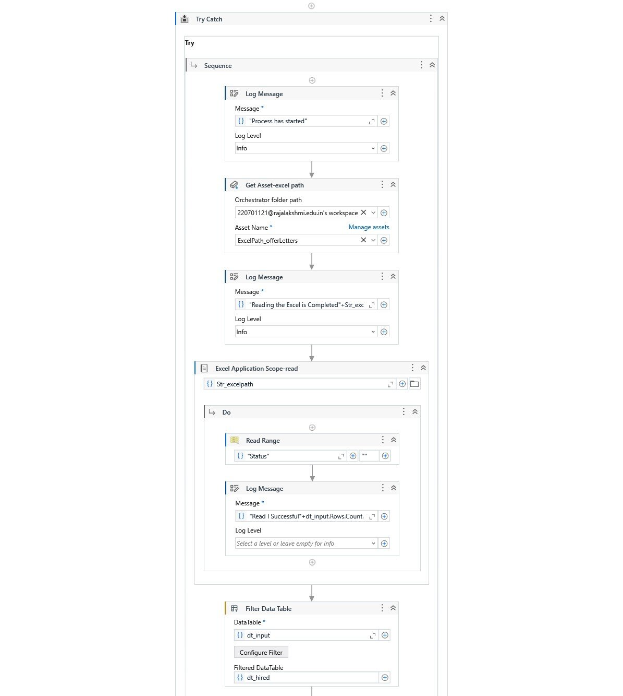
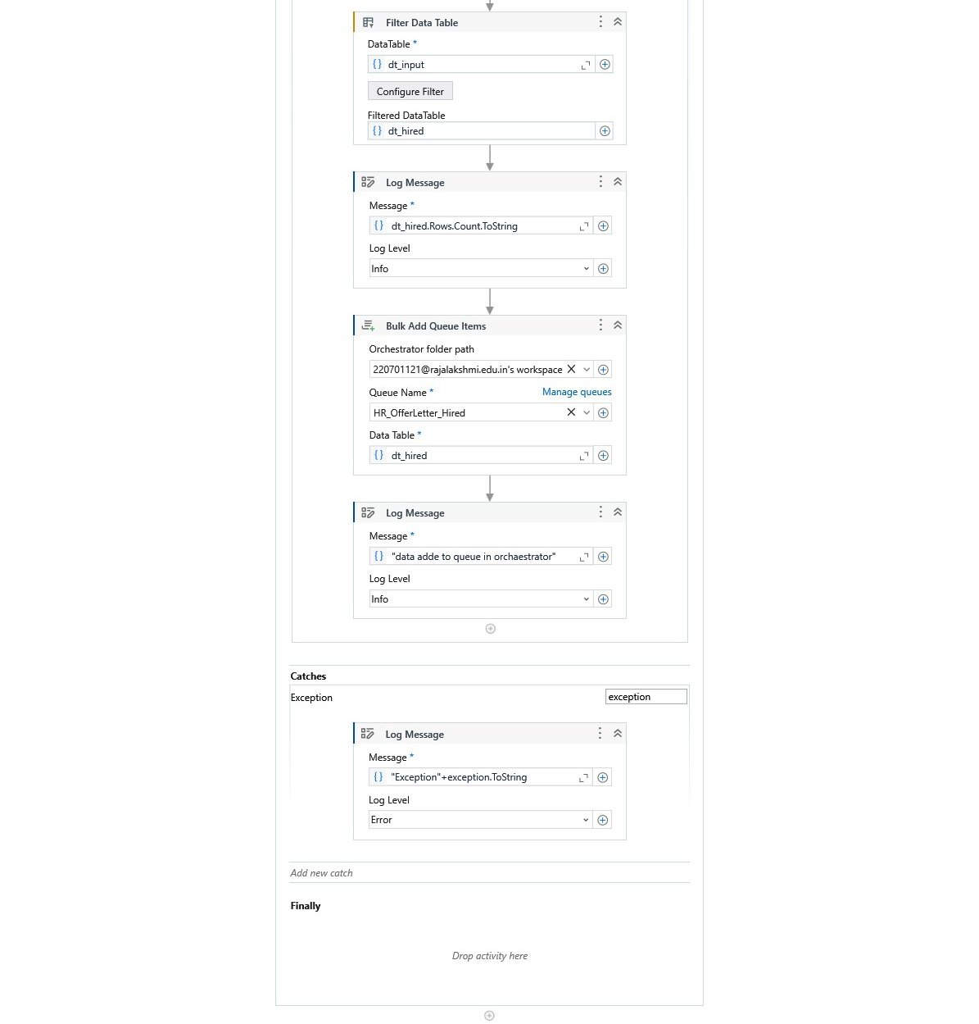
Implementation
Implementation of Module 1: Candidate Data Processing
This module extracts candidate information from an Excel sheet, filters those marked as "Hired," and validates their details.

Slide 16
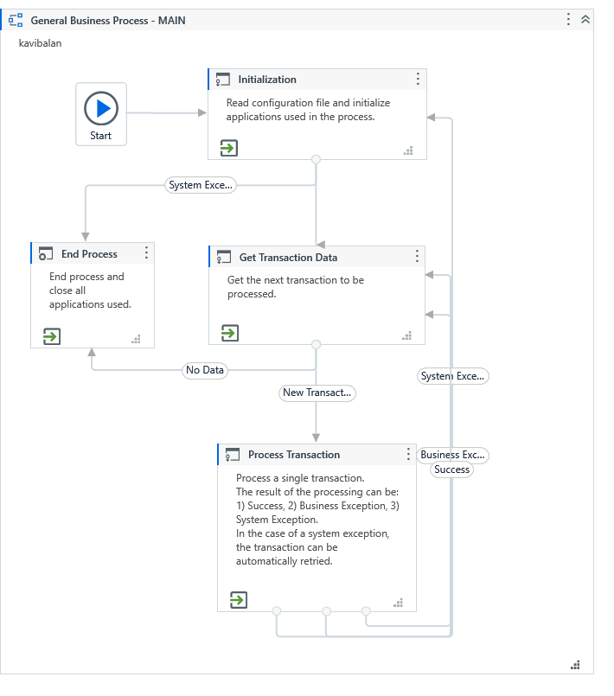
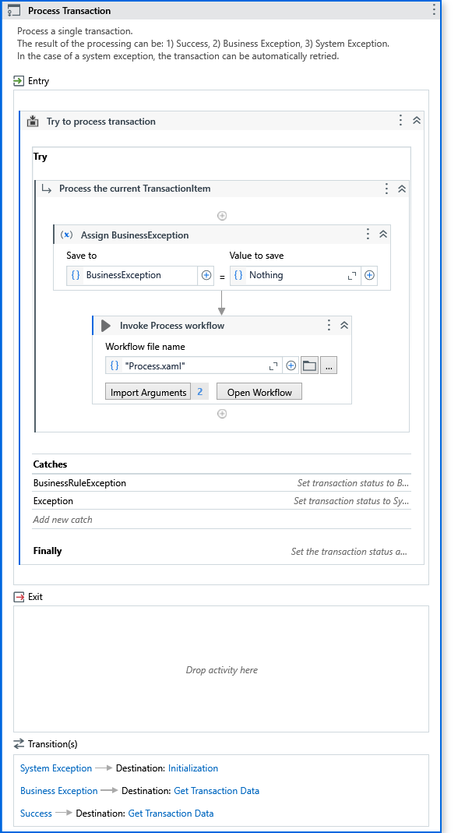
Implementation
Implementation of Module 2: Offer Letter Generation and Emailing This module generates personalized offer letters using templates and sends them via SMTP email to the candidates.

Slide 17
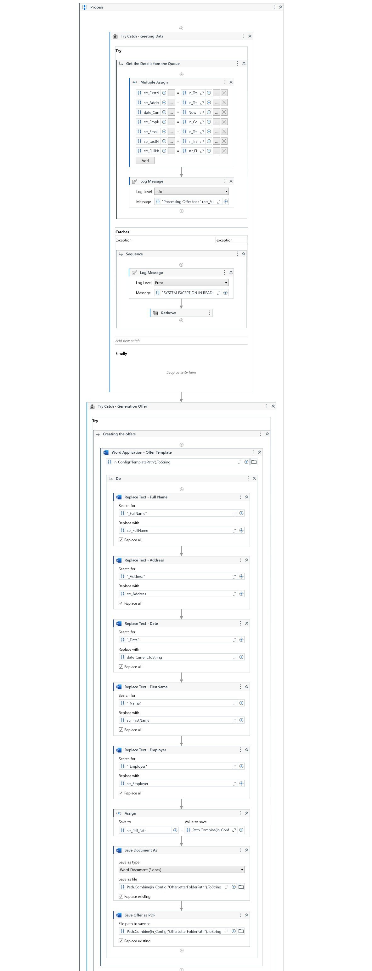
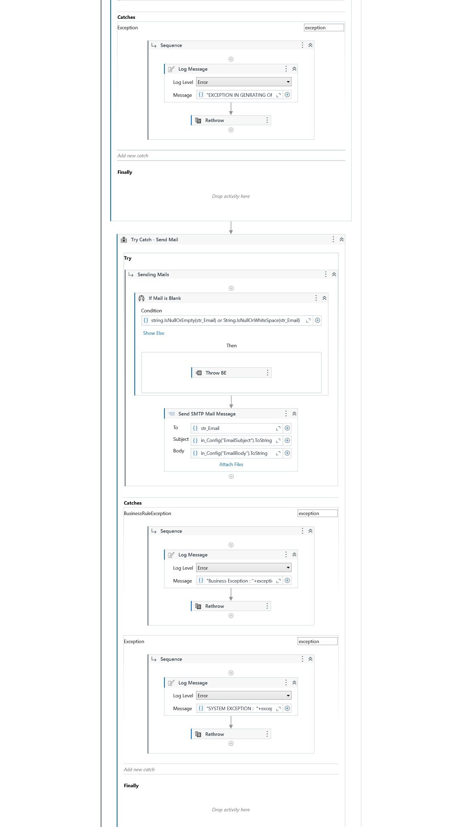
Implementation

Slide 18
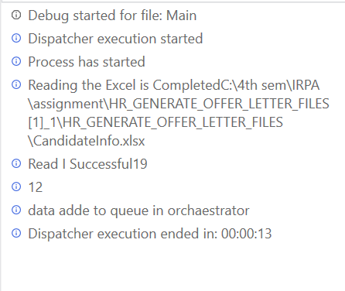
Testing
Testing Logs
Contains a record of the testing process, including:
Test steps.
Test case IDs.
Expected vs. actual results.
Notes on identified issues and resolutions.

Slide 19
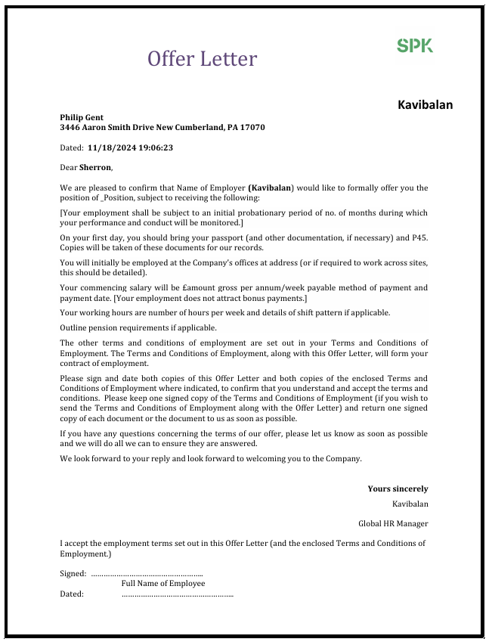
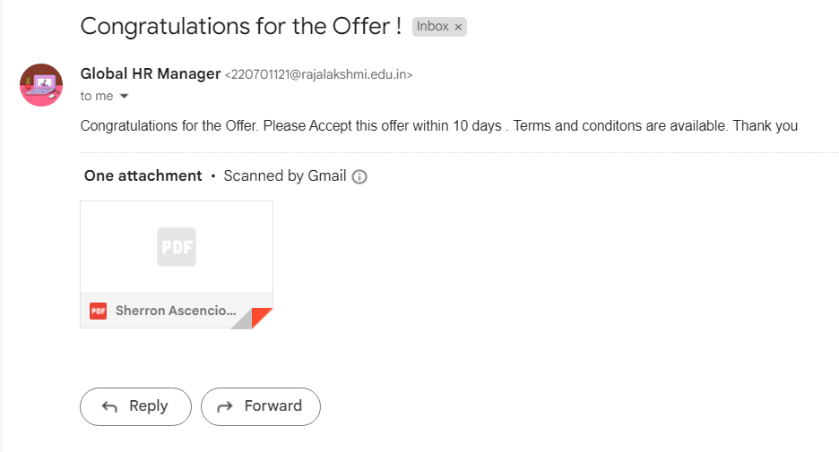
Testing
Sample Letter:
Contains a Sample Letter Generated using the
RE Bot including:
Employee Name
Date of Edited
Address of the Employee

Slide 20
Conclusions
The project successfully demonstrates the automation of recruitment letter generation, leveraging UiPath's RE Framework to streamline and enhance the hiring process. By efficiently reading candidate data from Excel, generating personalized offer letters, and dispatching them via email, the system reduces manual effort, eliminates errors, and accelerates recruitment workflows. This innovative approach not only saves time but also ensures consistency and professionalism in communication with candidates. The implementation serves as a practical solution for HR teams and can be scaled or enhanced with advanced features like integration with ATS platforms and AI-based personalization for future applications.

Slide 21
Future Enhancement
Description 1: Integration with Applicant Tracking Systems (ATS)
The current system can be enhanced by integrating it with ATS platforms, allowing seamless data import of candidate information directly from recruitment portals. This will eliminate the need for manual data entry in Excel, improving efficiency and accuracy.
Description 2: Advanced Personalization with AI
Incorporate Natural Language Processing (NLP) to personalize offer letters further by analyzing candidate profiles and tailoring messages. For instance, the system can include role-specific greetings or reference past achievements mentioned in the candidate’s resume, providing a more customized experience.

Slide 22
IEEE Paper
Robotic Process Automation for Software Project Management Chinmayee Nitin Rajadhyaksha; Jatinderkumar R. Saini 2022 IEEE 7th International conference for Convergence in Technology (I2CT)Year: 2022 | Conference Paper | Publisher: IEEE
Use Of RPA For Email Automation With Salesforce Integration Sahil Bhosale;Rajesh Dhumal;Vidya Patkar;T.P Singh 2023 IEEE 5th International Conference on Cybernetics, Cognition and Machine Learning Applications (ICCCMLA)Year: 2023 | Conference Paper | Publisher: IEEE

Slide 23
References
Flowcharts: Studio - Flowcharts (uipath.com)
Data scraping: Studio - About Data Scraping (uipath.com)
Email activity: Activities - Send SMTP Mail Message (uipath.com)
Email activity: https://youtu.be/8vlLvsyCO3Q

Slide 24
Queries

Slide 25
Demonstration

Slide 26
Thank You

